Slide 1
Multimodal AI
Pius Mugagga

Slide 2
What is multimodal AI?
Multimodal: Multiple Modalities (of sensing or inputs)
AI (models/systems) that utilise more than a single input for simultanious processing

Slide 3
Disembodied Muultimodal AI
Abstract AI agent (model) that doesn’t interact directly with the environment.
Common Inputs: Text, speech, images.
Applications:
Gemini, GPT-4o, Claude,etc… primarily reasoning models built using audio(language)-visual data. Also commonly reffered to as Language Visual Models (LVMs)
These often extend into the healthcare domain

Slide 4
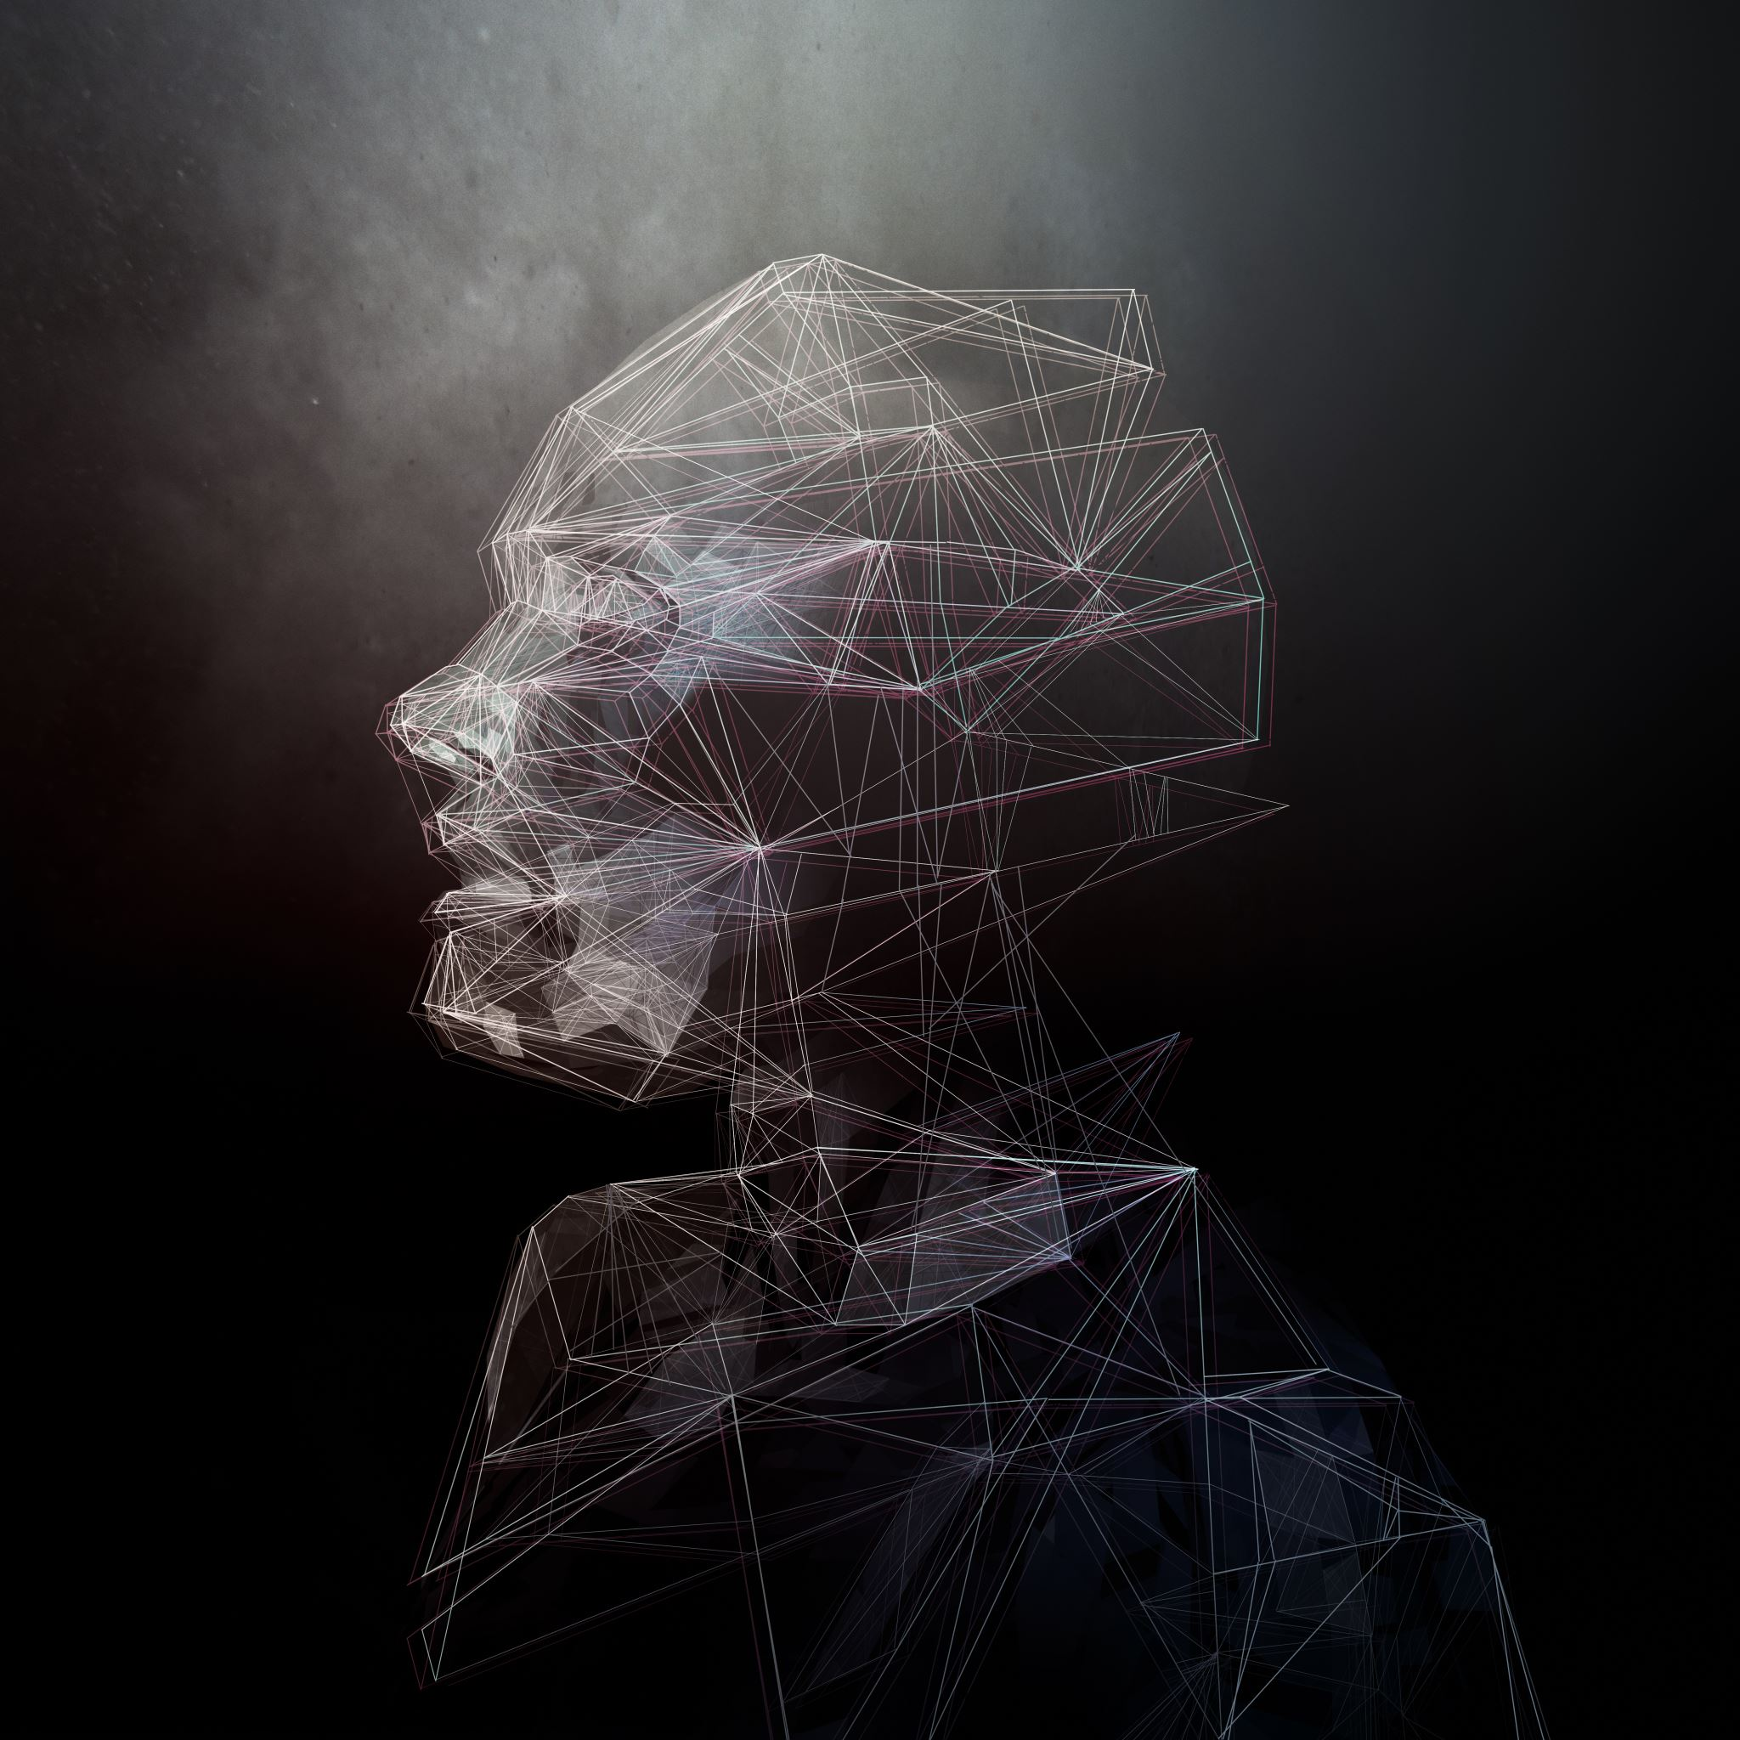
Embodied Muultimodal AI
Embodied: AI agent interacts directly with an environment (virtual or real)
Modalities processed together
Often complementary
Helps add deeper context

Slide 5
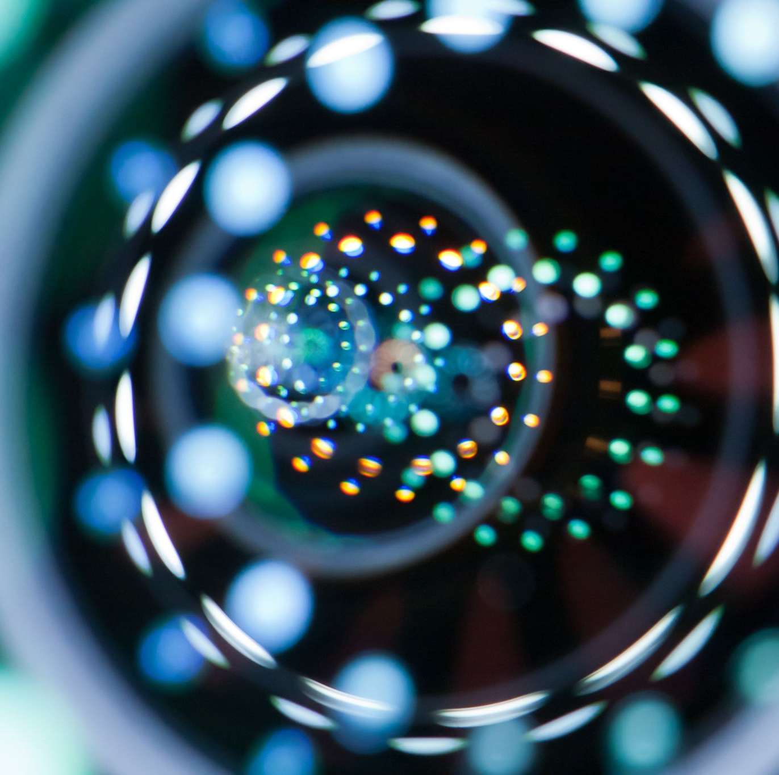
Multimodal Data Fusion
Early Fusion
Late Fusion
Hybrid Fusion

Slide 6
Representation Learning
Deep Networks
Knowledge graphs

Slide 7
Challenges
Hardware and infrastructure challenges
Foundation model challenges
Sim2Real and digital twin challenges
Multimodal learning challenges
Physical world understanding challenges
Industrial and application challenges
Ethical and societal challenges

